Slide 1

Machine Learning and Artificial Intelligence
Instructors: Shurui Li, Daniel Ahn
Slides are adapted from previous year’s slides
Notes:
Hello everyone I’m Shurui, a current PhD student of UCLA EE department. today I’m going to give you the first lecture on machine learning, which is about the introduction, linear regression and perceptron.

Slide 2
Contents
What is Machine Learning?
Difference between ML and AI
Types of Learning
Applications
Elements of a ML problem
Linear regression
Perceptron

Slide 3
What is machine learning
“Field of study that gives computers the ability to learn without being explicitly programmed“ – Arthur Samuel
“How can we build computer systems that automatically improve with experience, and what are the fundamental laws that govern all learning processes?” – Tom Mitchell
Main idea: software/algorithms that can improve on a task based on data and previous experience. In other words: Let computers learn automatically without human intervention.

Slide 4
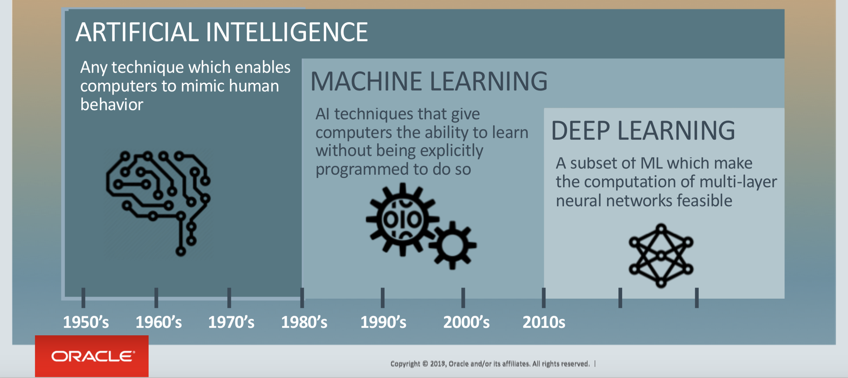
Difference between ML and AI

Slide 5
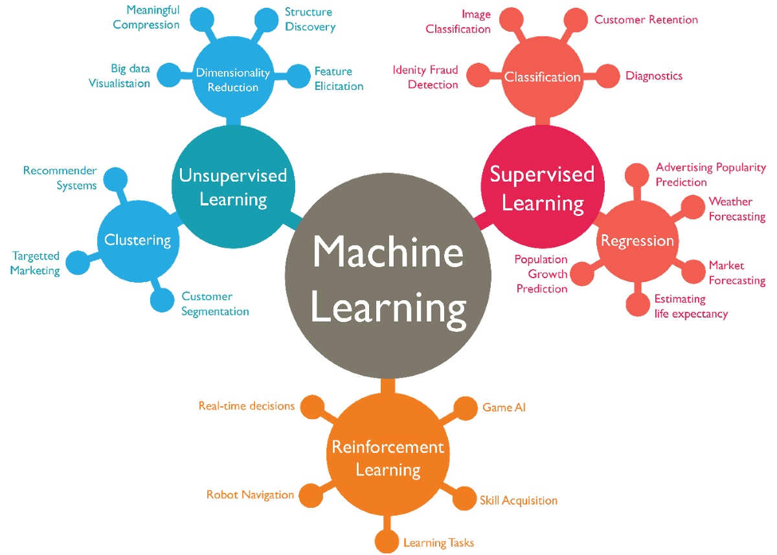
Source: dzone.com
Notes:
Explain the difference between unsupervised learning and supervised learning (with or without label). Unsupervised is like self-learning, without a teacher teaching you the truth. RL is learning by interacting with an environment. It has an action-reward system, which is kind of trial and error learning. Details will be in the next few slides.

Slide 6
Types of learning
1. Supervised Learning (task driven)
Training data set is well-labeled with the desired output.
Examples
Classification
Email spam detector
Facial recognition / thumbprint recognition
Speech recognition (Siri, Alexa, etc.)
Image classification
Prediction
Housing price estimate (Zillow)
Stock market

Slide 7
Types of learning
2. Unsupervised Learning (data driven)
No desired output label is given to the training data.
Can be used to find hidden patterns/structure in data.
Examples
Clustering
Shoppers into similar behaviors
Marketing strategies (ex: charities)
Recommendations (Netflix, Pandora, etc.)
Anomaly Detection
Credit card fraud / Banking fraud
Network Traffic Anomalies
Association Rule Learning
Learning a new language (without native translation)
Purchase hotdogs + ketchup = also purchase hotdog buns
Notes:
Clustering method will be covered in afternoon lecture.

Slide 8
Types of learning
3. Reinforcement Learning (environment driven)
Interacts with dynamic environment.
Receives positive and negative feedback.
Examples
Complex board games (chess, go, etc.)
Why not tic-tac-toe, connect-4, checkers, etc?
Video games
Self-driving cars / drones
Robotics
More efficient methods
Additional tasks

Slide 9
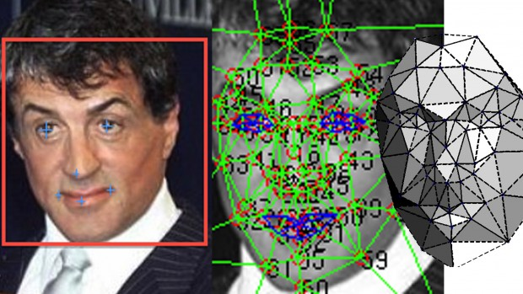
Applications of machine learning
One important application of machine learning is classification
Classify some data as belonging to a category
Several examples:
Spam email detection
Used in most email service providers
Data is the content of emails
Facial recognition
Used for identity identification
Commonly used in smart phones, security systems, etc.
Data is face images
Image recognition
Used to identify what is in the given picture
A wide range of applications, e.g., robots, drones, medical diagnosis, your phone’s gallery software
Data is just images

Slide 10
Application of machine learning
Another important application of machine learning is prediction (regression)
Predict the possible outputs (non-discrete) based on past experiences
Several examples
Recommendation systems
Used to recommend contents that users are interested in
Widely used in all kinds of apps & websites, e.g., YouTube, Tiktok, Amazon, Netflix, web browser, ads
Data is users’ history and behavior, e.g., browsing/shopping/watching history, past user feedback, time spent, or even scroll frequency!
Various forecasts
Predict possible results based on history
Examples: electricity usage prediction, company revenue prediction, winning probability of your favorite sport team, or even the stock price (well… probably not this one)
Data can be almost anything and is task and model dependent: e.g., injury status of a basketball team, or past revenue of a company

Slide 11
Some fun examples of robots
BRETT: Berkeley Robot for the Elimination of Tedious Tasks
https://www.youtube.com/watch?v=JeVppkoloXs
Not preprogrammed with knowledge how to accomplish specific tasks.
Starfish Walking Robot
https://www.youtube.com/watch?v=ehno85yI-sA
Taught itself to walk.
Google DeepMind AI taught itself how to walk.
https://www.youtube.com/watch?v=gn4nRCC9TwQ
https://deepmind.com/blog/producing-flexible-behaviours-simulated-environments/#gif-90
Boston Dynamics
https://www.youtube.com/watch?v=4PaTWufUqqU

Slide 12
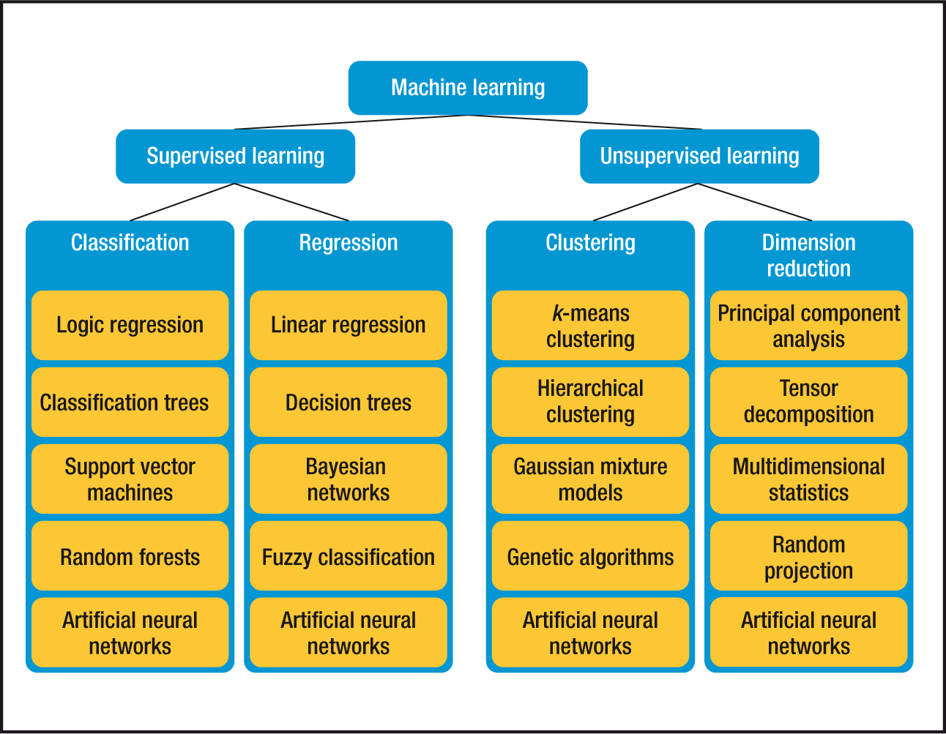
Various machine learning algorithms
How to choose the best approach for a particular problem?
A: It’s a hard one and can be very complicated, but there’s still some rule of thumbs

Slide 13
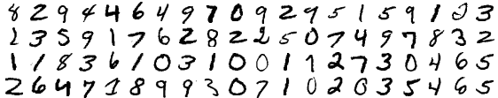
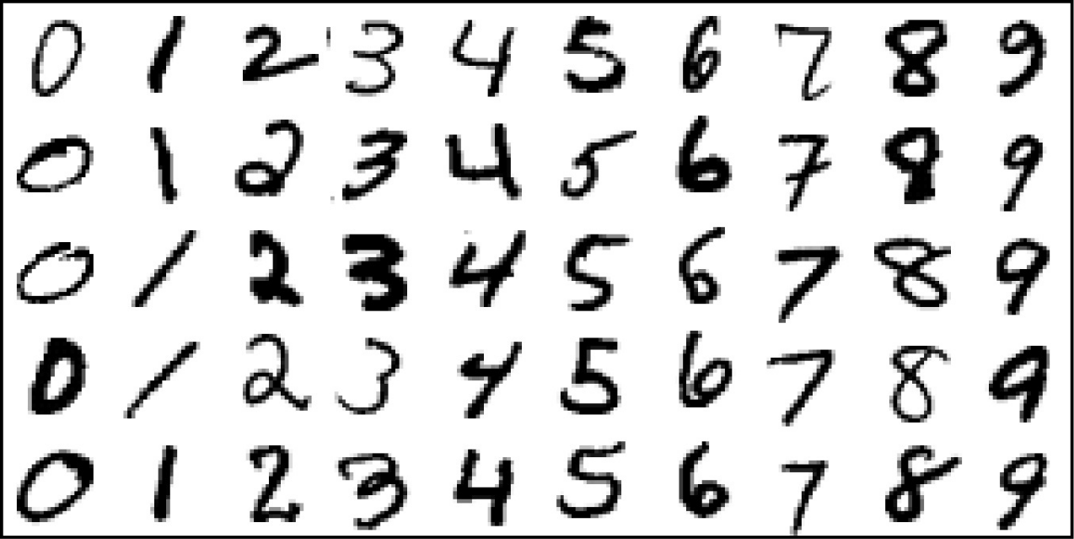
Elements of a ML problem: inputs
Let’s start with supervised learning.
First, we get some inputs.
Lots of equivalent terminology from different fields. Also called:
Predictors
Independent variables
Features
Inputs have some influence on outputs. The goal is to use inputs to predict the outputs.
Example: identifying handwritten digits.
Our algorithm is now trained, apply it to the test set:
Inputs: Training Set
Corresponding Labels:
8 2 9 4 4 6 4 9 …

Slide 14
Data is the key!
The input used for training the algorithm (commonly called data) is extremely important for good learning results
It is as important as the learning model/algorithm design, if not more important to
No algorithm can learn anything useful from incorrect or invalid data
Learning results strongly depends on the number and quality of data
Learning algorithm choice also depends on the amount of training data
<50: get more data!
50-10K: non deep learning methods. e.g., regression, SVM, random forest, etc.
>10k: go for deep learning (neural networks) for better results
Lots of data pre-processing and filtering techniques to improve the quality of data

Slide 15
Elements of a ML problem: outputs
Now let’s talk about outputs
As we saw, the outputs vary with the type of problem
Can be quantitative (a number)
For example, predicting ad revenues
Can be qualitative (no numerical relationship between the outputs)
Our classification tasks.
Going back to our classification/regression idea:
Predicting quantitative outputs: regression
Predicting qualitative outputs: classification
Another option is “ordered categorical”
For example, “small, medium, large”. There’s an order, but it’s not numerically set (large-medium isn’t necessarily the same as medium-small.)

Slide 16
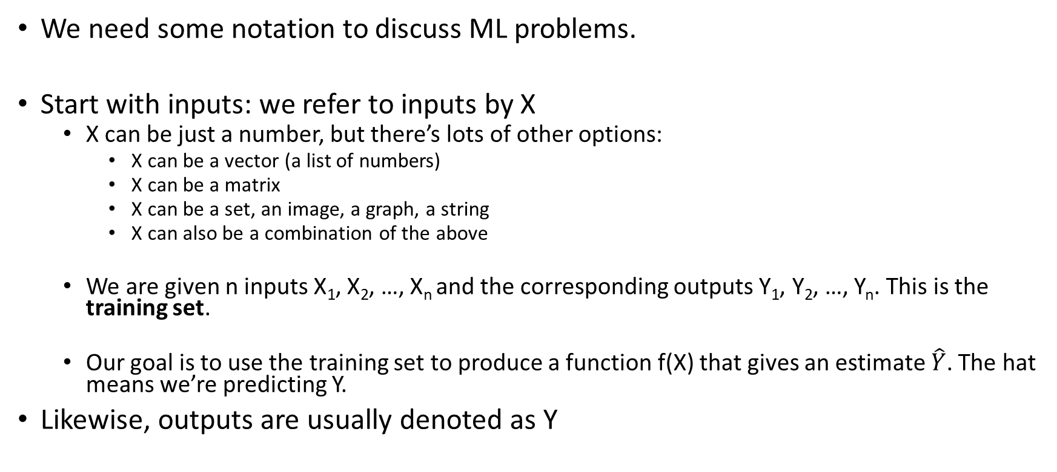
Elements of a ML problem: notation
We need some notation to discuss ML problems.
Start with inputs: we refer to inputs by X
X can be just a number, but there’s lots of other options:
X can be a vector (a list of numbers)
X can be a matrix
X can be a set, an image, a graph, a string
X can also be a combination of the above
We are given n inputs X₁, X₂, …, X_{n} and the corresponding outputs Y₁, Y₂, …, Y_{n}. This is the training set.
Our goal is to use the training set to produce a function f(X) that gives an estimate $\hat{Y}$. The hat means we’re predicting Y.
Likewise, outputs are usually denoted as Y

Slide 17
Linear prediction
Simplest method for regression tasks, but also widely used
Essentially ‘line fitting’

Slide 18
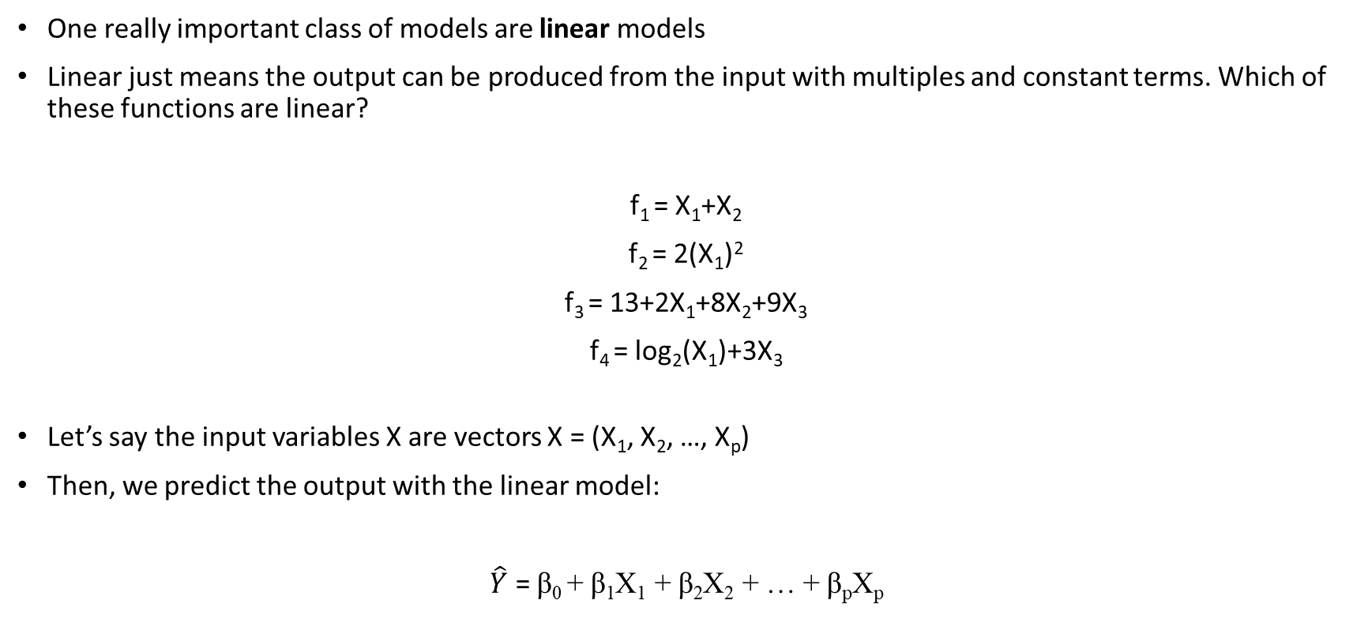
Linear Prediction
One really important class of models are linear models
Linear just means the output can be produced from the input with multiples and constant terms. Which of these functions are linear?
f₁ = X₁+X₂
f₂ = 2(X₁)²
f₃ = 13+2X₁+8X₂+9X₃
f₄ = log₂(X₁)+3X₃
Let’s say the input variables X are vectors X = (X₁, X₂, …, X_{p})
Then, we predict the output with the linear model:
$\hat{Y}$ = β₀ + β₁X₁ + β₂X₂ + … + β_{p}X_{p}

Slide 19
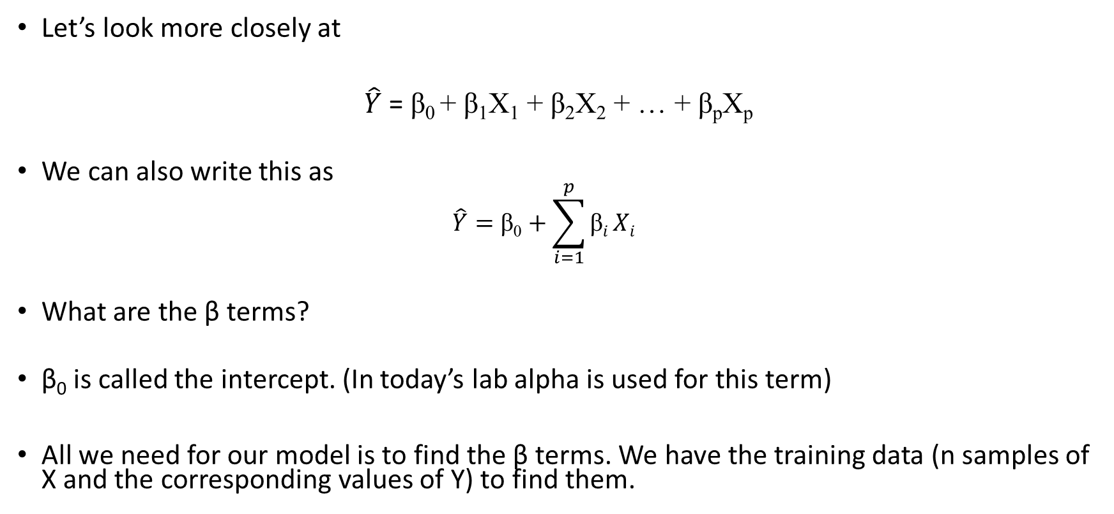
Linear Prediction
Let’s look more closely at
$\hat{Y}$ = β₀ + β₁X₁ + β₂X₂ + … + β_{p}X_{p}
We can also write this as
$$\hat{Y}=\text{β}\text{0}+\sum_{i=1}^{p}{\text{β}i}Xi$$
What are the β terms?
β₀ is called the intercept. (In today’s lab alpha is used for this term)
All we need for our model is to find the β terms. We have the training data (n samples of X and the corresponding values of Y) to find them.

Slide 20
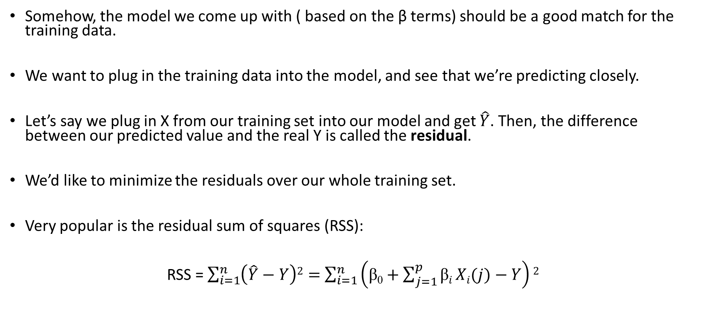
Linear Prediction
Somehow, the model we come up with ( based on the β terms) should be a good match for the training data.
We want to plug in the training data into the model, and see that we’re predicting closely.
Let’s say we plug in X from our training set into our model and get $\hat{Y}$. Then, the difference between our predicted value and the real Y is called the residual.
We’d like to minimize the residuals over our whole training set.
Very popular is the residual sum of squares (RSS):
RSS = $\sum_{i=1}^{n}{\left(\hat{Y}−Y\right)2}=$ $\sum_{i=1}^{n}{\left(\text{β}\text{0}+\sum_{j=1}^{p}{\text{β}i}Xi(j)−Y\right)2}$

Slide 21
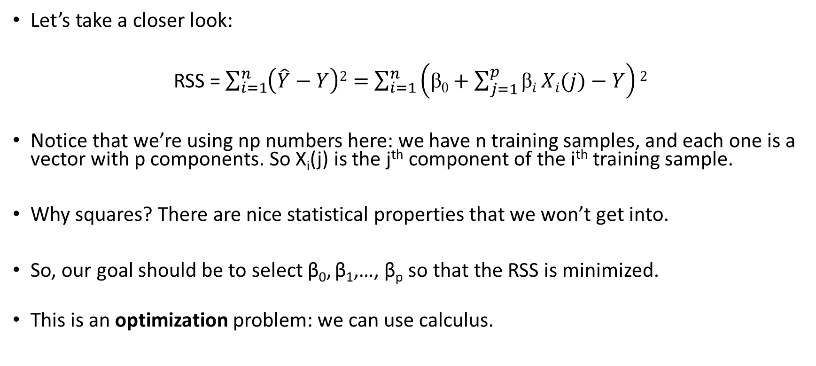
Linear Prediction
Let’s take a closer look:
RSS = $\sum_{i=1}^{n}{\left(\hat{Y}−Y\right)2}=$ $\sum_{i=1}^{n}{\left(\text{β}\text{0}+\sum_{j=1}^{p}{\text{β}i}Xi(j)−Y\right)2}$
Notice that we’re using np numbers here: we have n training samples, and each one is a vector with p components. So X_{i}(j) is the j^{th} component of the i^{th} training sample.
Why squares? There are nice statistical properties that we won’t get into.
So, our goal should be to select β₀, β₁,…, β_{p} so that the RSS is minimized.
This is an optimization problem: we can use calculus.

Slide 22
Little bit of matrices/calculus
OK, so the RSS above looked scary. Let’s use some vectors to make it look nice:
Make Y a vector (y₁,…,y_{N})^{T}. Then, make X a matrix that is N x p. Also, set β = (β₀, β₁,…, β_{p})^{T}. Then, we can write the RSS above in the simple notation:
RSS = (y-Xβ)^{T}(y-Xβ)
Since we want to minimize the RSS, we can take the derivative and set it to 0. We get
X^{T}(y-Xβ)=0
Solving,
β =(X^{T}X)⁻¹X^{T}y

Slide 23
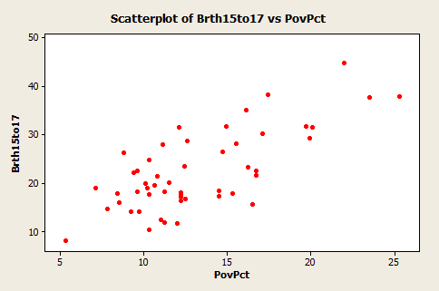
A regression example
Example: Teen birth rate and poverty level data
Use linear regression to fit the line!

Slide 24
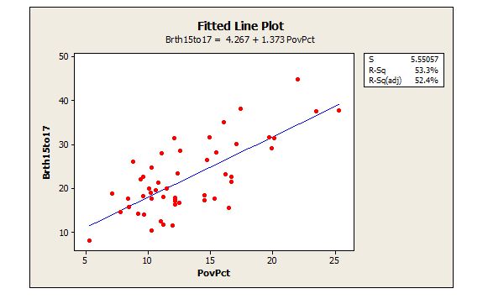
A regression example
After fitting the line that minimizes the RSS of training data, we can predict the birth rate given the poverty rate

Slide 25
Another example:
Let’s look at a case where we’re predicting outputs Y from X₁ and X₂.
Our model is a plane (linear!). The training data is the points in red. The slope of the plane is chosen to minimize the distance of the plane to all the red dots.
Harder to visualize for more than 2 dimensions.

Slide 26
Drawback of linear prediction
Not all relationship are linear in real life (probably most of them are not)
Linear prediction on its own works poorly on data with high dimensions (some information are less important than others)
Need other learning algorithms for those data, e.g. , dimension reduction methods, random forest, neural networks

Slide 27
An introduction to perceptron
Perceptron is similar to linear regression. It is originally designed for binary classification problem.
The perceptron
A linear model for classification
An algorithm to learn feature weights given labeled data
Online algorithm
Error-driven
The basis of modern deep neural network, perceptron is a good introduction to deep learning (covered in tomorrow)

Slide 28
Perceptron Learning Algorithm
First neural network learning model in the 1960’s
Simple and limited (single layer models)
Basic concepts are similar for multi-layer models so this is a good learning tool
Still used in current applications (modems, etc.)

Slide 29
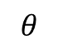
Perceptron Node – Threshold Logic Unit
x₁
w₁
x₂
w₂
$$θ$$
z
x_{n}
w_{n}

Slide 30
Perceptron Node – Threshold Logic Unit
x₁
w₁
x₂
w₂
$$θ$$
z
x_{n}
w_{n}
Learn weights such that an objective function is maximized.
What objective function should we use?
What learning algorithm should we use?
Notes:
What parameters and objective function

Slide 31
Perceptron Learning Algorithm
x₁
.4
.1
z
x₂
-.2
x₁
x₂
t
.8
.3
1
.4
.1
0

Slide 32
First Training Instance
.8
.4
.1
z
=1
.3
-.2
net = .8*.4 + .3*-.2 = .26
x₁
x₂
t
.8
.3
1
.4
.1
0

Slide 33
Second Training Instance
.4
.4
.1
z
=1
.1
-.2
net = .4*.4 + .1*-.2 = .14
x₁
x₂
t
.8
.3
1
Δw_{i} =
(t - z)
∗ c
∗ x_{i}
.4
.1
0
Notes:
C here is the learning rate, which controls the speed of convergence of the training algorithm

Slide 34
Perceptron Rule Learning
Δw_{i} = c(t – z) x_{i}
Where w_{i} is the weight from input i to perceptron node, c is the learning rate, t is the target for the current instance, z is the current output, and x_{i} is i^{th} input
Least perturbation principle
Only change weights if there is an error
small c rather than changing weights sufficient to make current pattern correct
Scale by x_{i}
Create a perceptron node with n inputs
Iteratively apply a pattern from the training set and apply the perceptron rule
Each iteration through the training set is an epoch
Continue training until total training set error ceases to improve
Perceptron Convergence Theorem: Guaranteed to find a solution in finite time if a solution exists
Notes:
Author uses y-t and thus negates the delta w

Slide 35
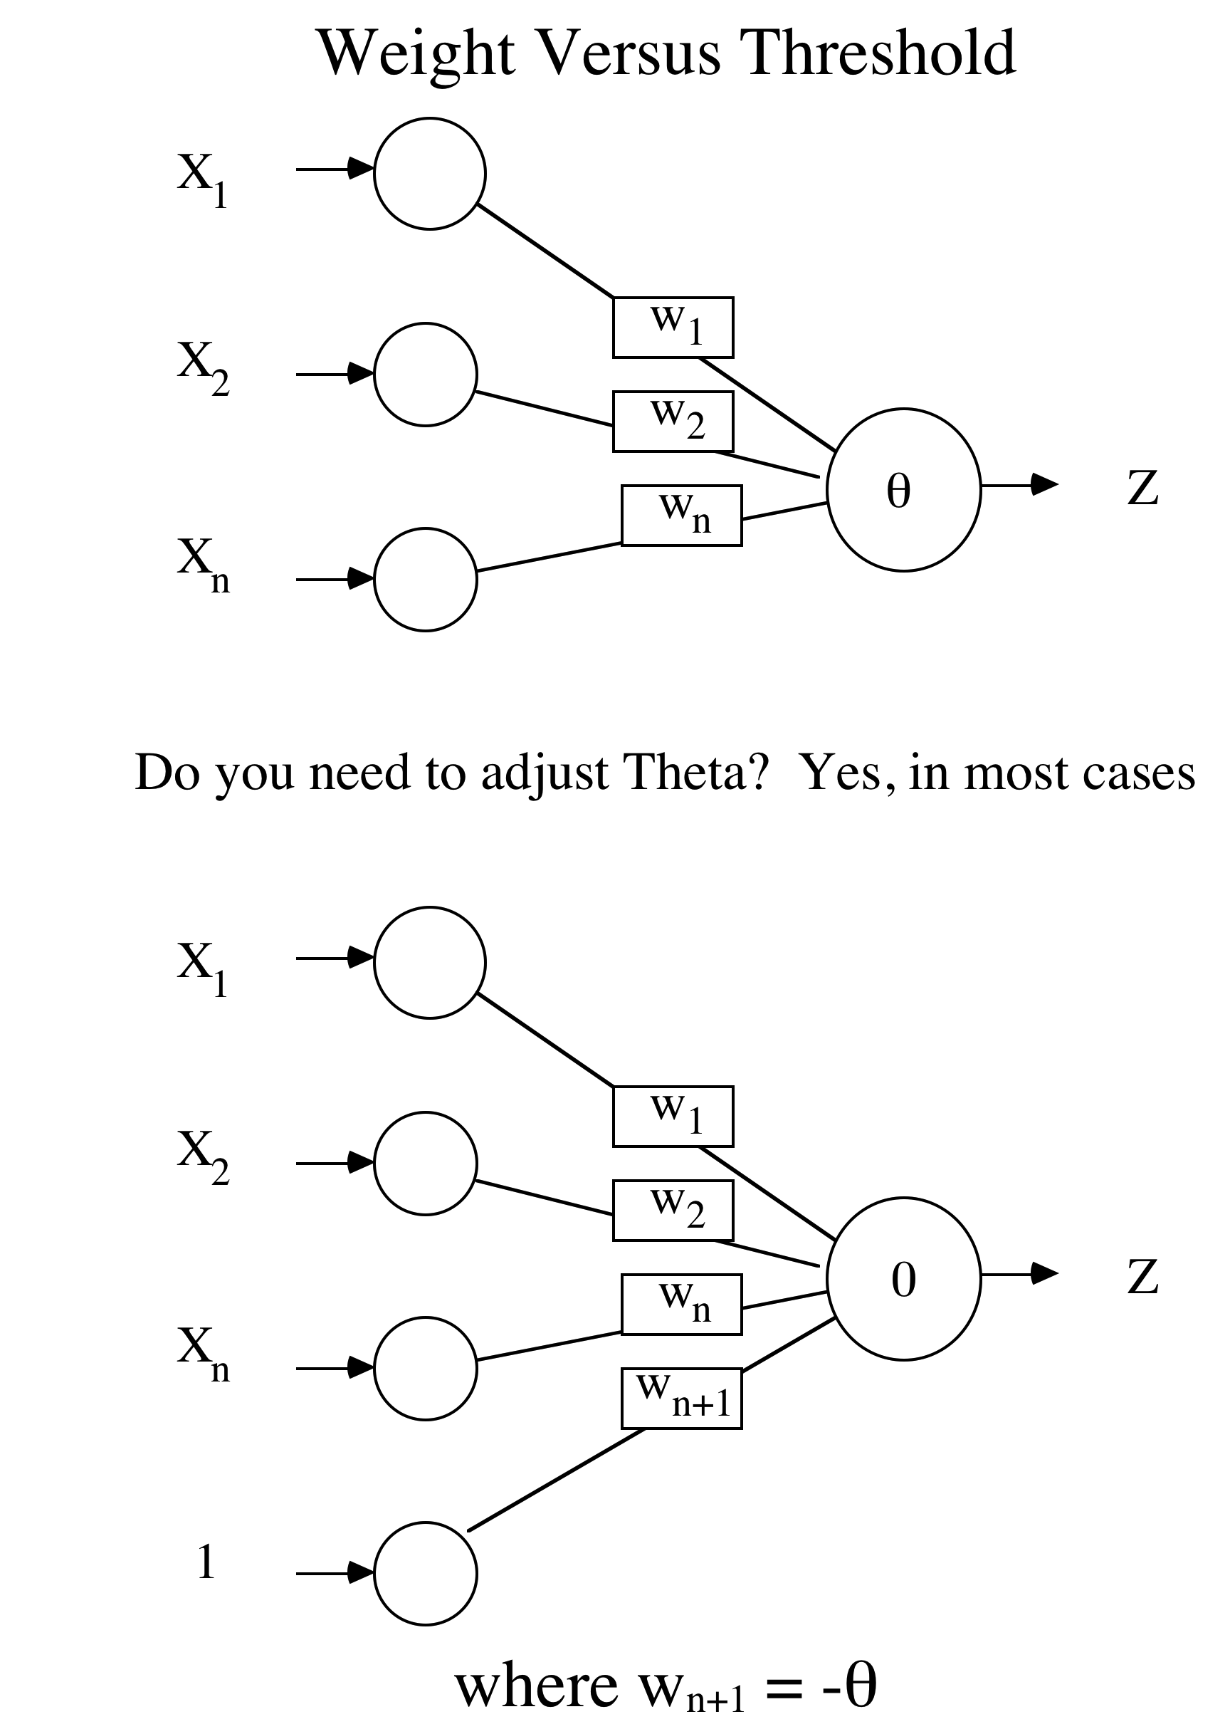

Slide 36
What does this actually do?
Let’s look at a classification example.
We want to define a linear boundary that selects whether a class of points is orange or blue:
Our linear function is just a line in the XY plane; if a point is above it, we classify it as orange. If it’s below, we classify it as blue.

Slide 37
What does this actually do?
Our linear function is just a line in the XY plane; if a point is above it, we classify it as orange. If it’s below, we classify it as blue.
The slope of the line β is selected to minimize the RSS of incorrect classification among all the points. We make orange 0, blue 1, so the residuals are always 0 or 1.

Slide 38
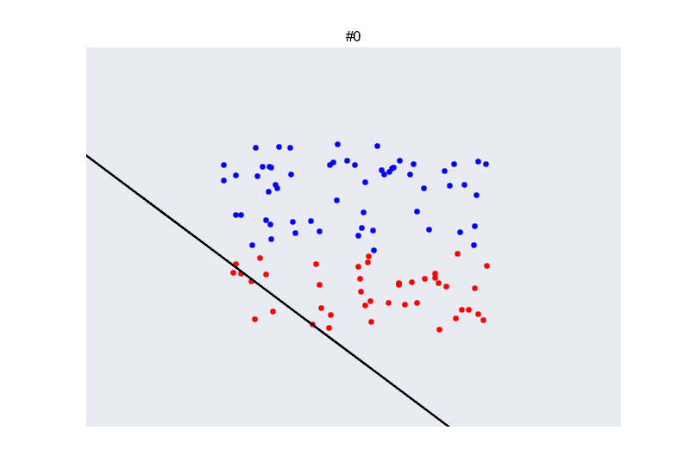
Visualization of perceptron
Source: miku/nntour: Neural nets intro @lpyug (github.com)

Slide 39
Time for coding!
The lab is divided into two parts
The first part:
The first part is designed to make you get familiar with all sort of things, and it contains three examples (2 for linear regression and 1 for perceptron)
Most of the codes are already written for you, you just need to write a few lines in general (just to make sure you understand the basics and not skipping everything ☺)
You will know whether your implementation is correct or not
The second part:
Two problems, one for regression and one for perceptron, you need to implement most of the codes yourself. (But should be relatively easy if you finish the first part)
Give you a sense of solving a real dataset/problem from beginning to end.
GitHub link for material download: UCLA-LACC-21/M4-ML-AI (github.com)
You need Lab1_part1&2.ipynb, USA_Housing.csv and advertising.csv
You need Colab as well to run the notebooks

